Slide 1


Presented By M6:
VINIT VIJAYKUMAR ADKE
YASH SANJAYKUMAR PARDESHI
JASWANTH GIRIDHARGOPALAN
DHIRRAJ SURESH KUMAR

Slide 2

Maximize distance travelled using DOE
Identify key design parameters (factors)
Recommend a high-performance, cost- effective design

Slide 3

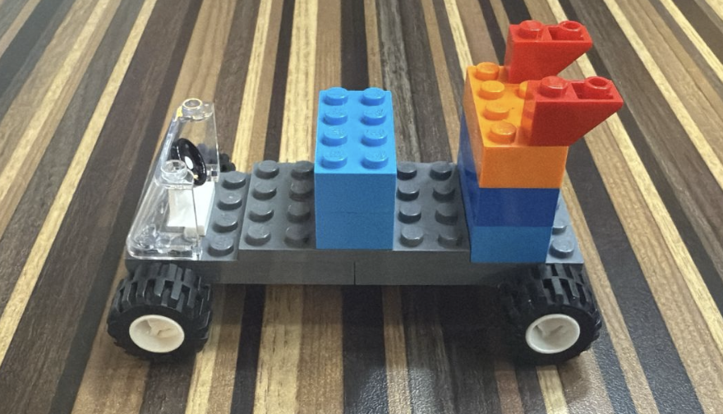
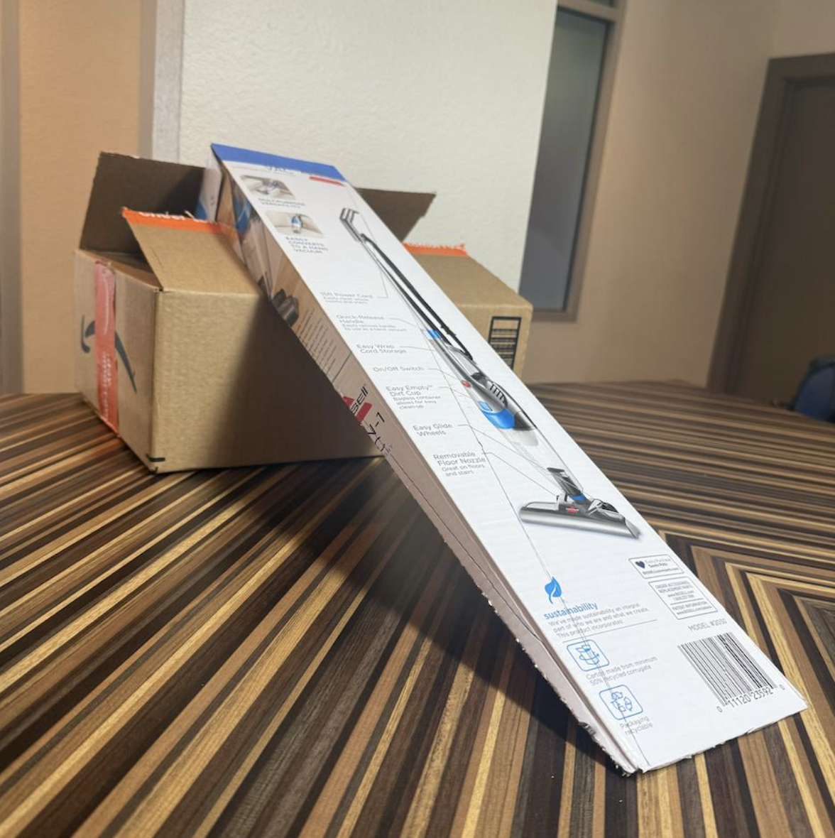
Procedure
Procedure
Constraints
Cars were released from the top of the ramp
Horizontal distance traveled from the end of the ramp to the car’s stopping point was measured
Randomized run order (generated by minitab)
2^4 full factorial * 3 replicates = 48 observations
Used Lego pieces those were provided.
Car design included mandatory windshield, steering wheel.

Slide 4

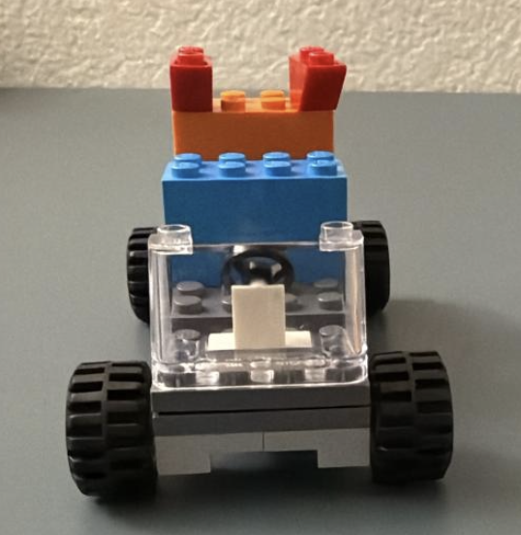
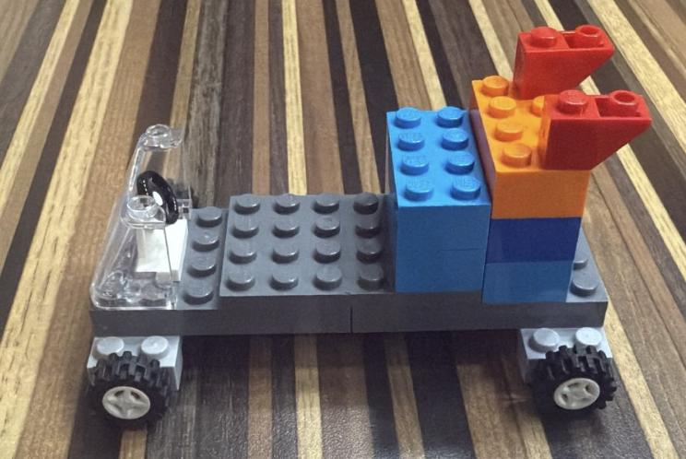
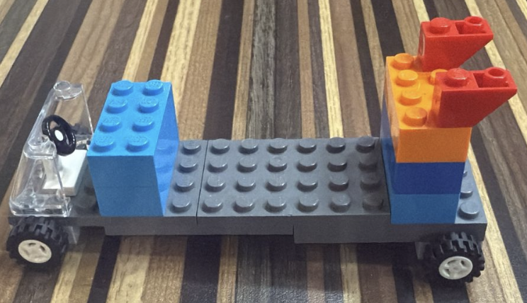
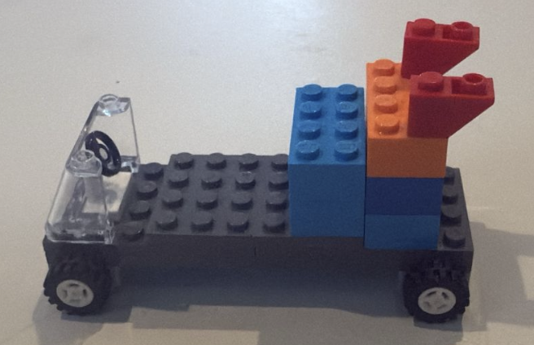
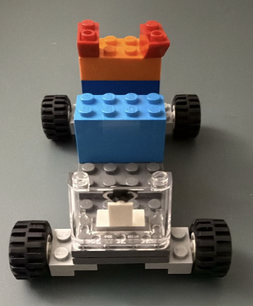
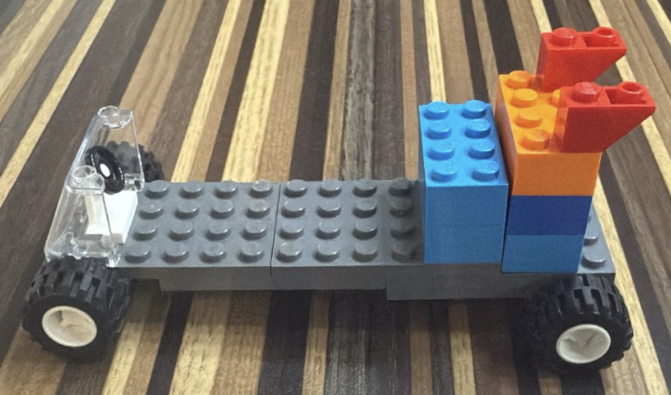
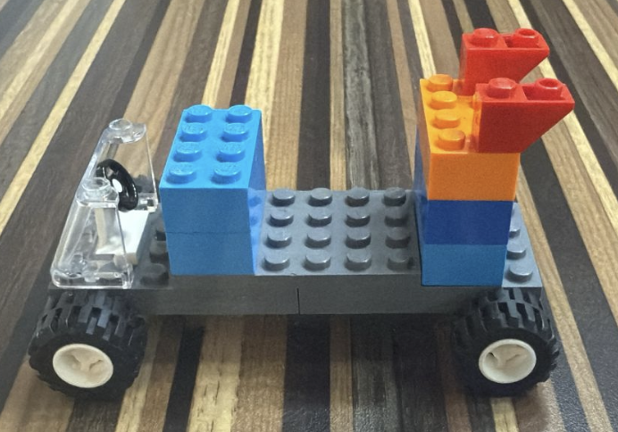
Length
Load Distribution
Width (Axle)
Tyre Size
Small:
Front:
Small:
Small:
Big:
Back:
Large:
Big:

Slide 5


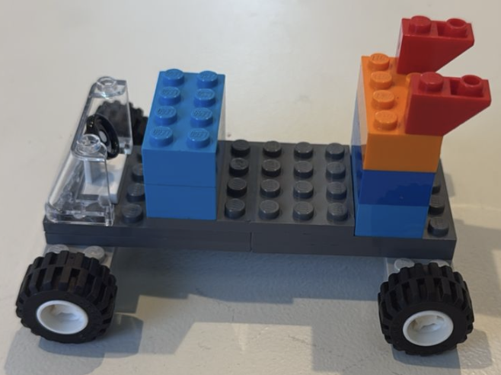
Horizontal distance travelled by the Lego car after leaving the ramp
Response Variable
2^4 full factorial design
UoM
Type Design
cms
Run 3 replications to reduce noise
Replications
Average of 3 repeated trails per design
Set
Randomization
Randomized run order from Minitab

Slide 6

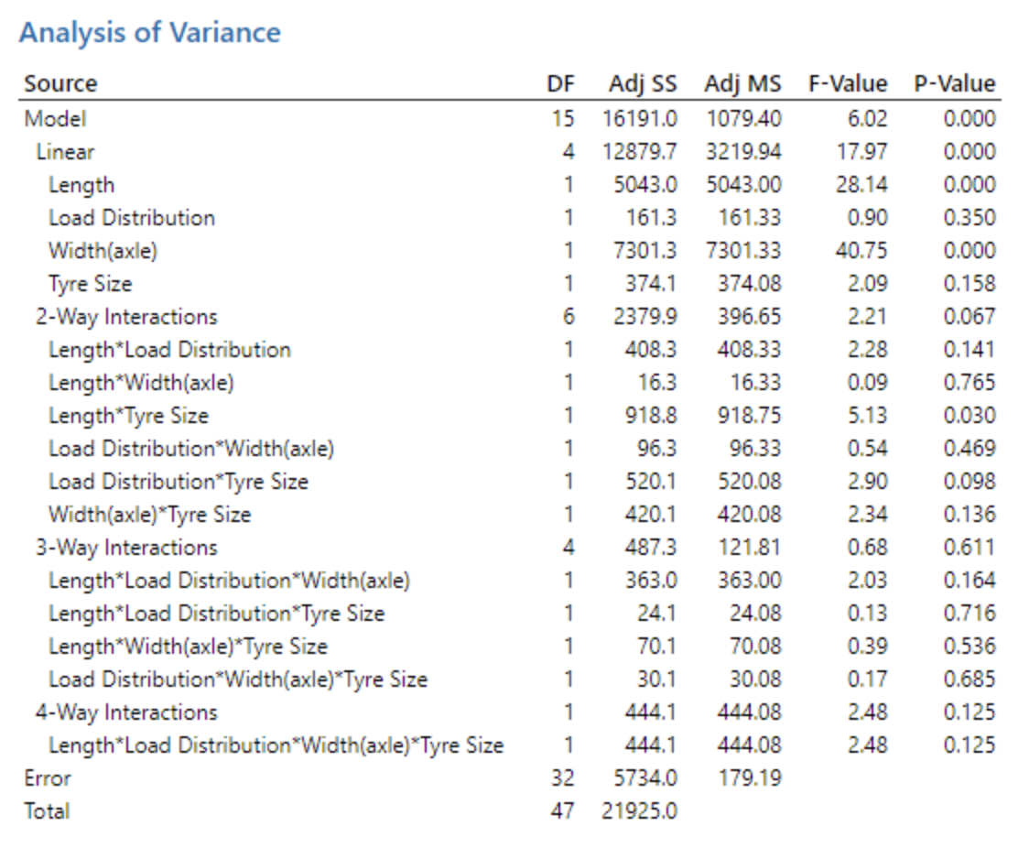
Significant Effects Identified:
Length (A): Strongly significant (p=0.000)
Width (C): Strongly significant (p=0.000) (Effect = 20.50, p = 0.000)
Length * Tyre Size(AD): Statistically significant (p=0.030)

Slide 7

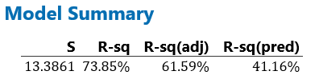
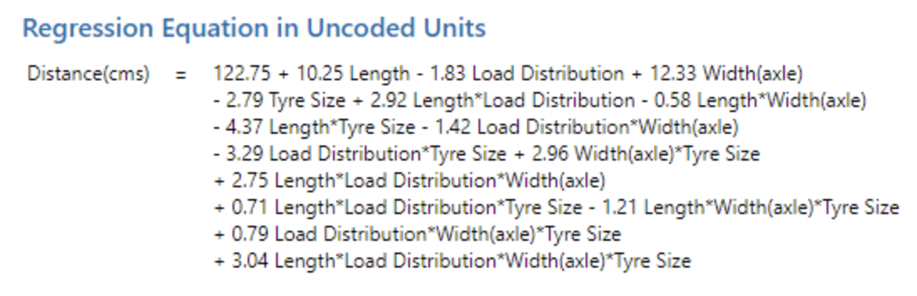
R-sq: 73.85% -> Strong proportion of the variability in the distance.
R-sq(adj): 61.59% -> Still shows decent model fit
R-sq(pred): 41.16% -> Moderate capability for predicting distance of new, untested design.
INTERPRETATION:
Good model fit, but potential for improvement in predictive performance

Slide 8

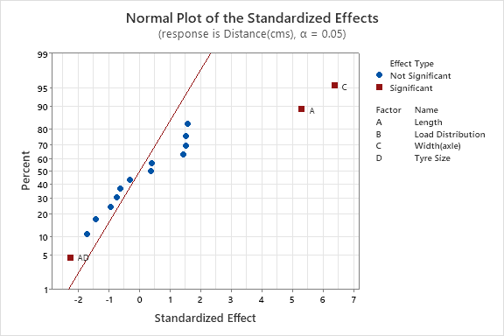
Significant Factors:
Length (A), Width (C), and the interaction Length * Tyre Size (AD) -> Outside reference line -> Statistical Significance

Slide 9
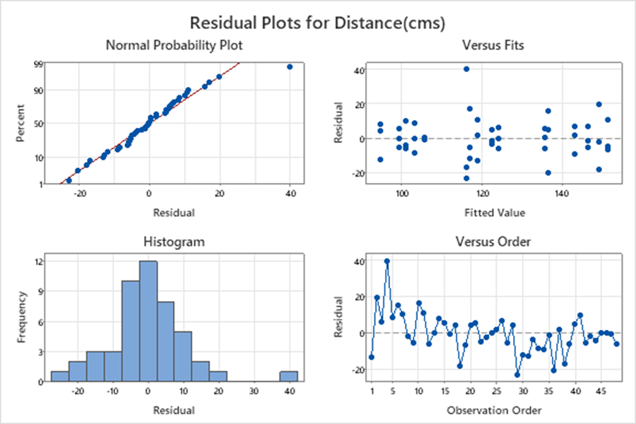
Normal Probability Plot: Points close to line -> residuals are normally distributed
Residuals vs Fits: Random scatter around zero -> constant variance
Histogram: Belly shaped -> Normality
Residuals vs Order: Points randomly scattered -> Errors are independent
CONCLUSION:
Suggests the model assumptions are adequately met.

Slide 10

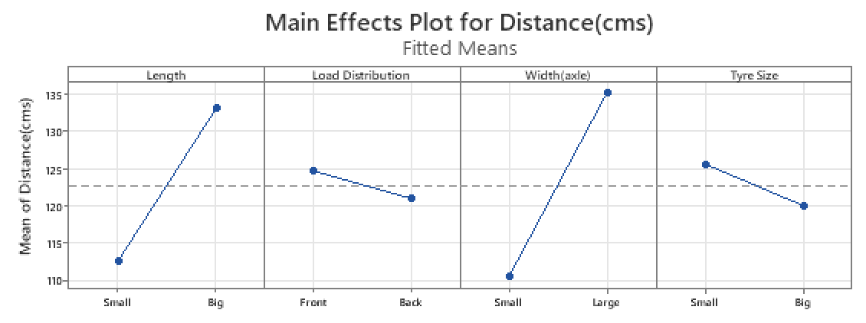
Length -> Strong +ve effect. Big Cars perform significantly better than small ones.
Load Distribution -> Front heavy designs slightly outperforms back-heavy ones -> Minimal Effect.
Width -> Large axle width greatly increases distance. Most influential factor..
Tyre Size -> Slightly –ve trend. No significant effect.

Slide 11

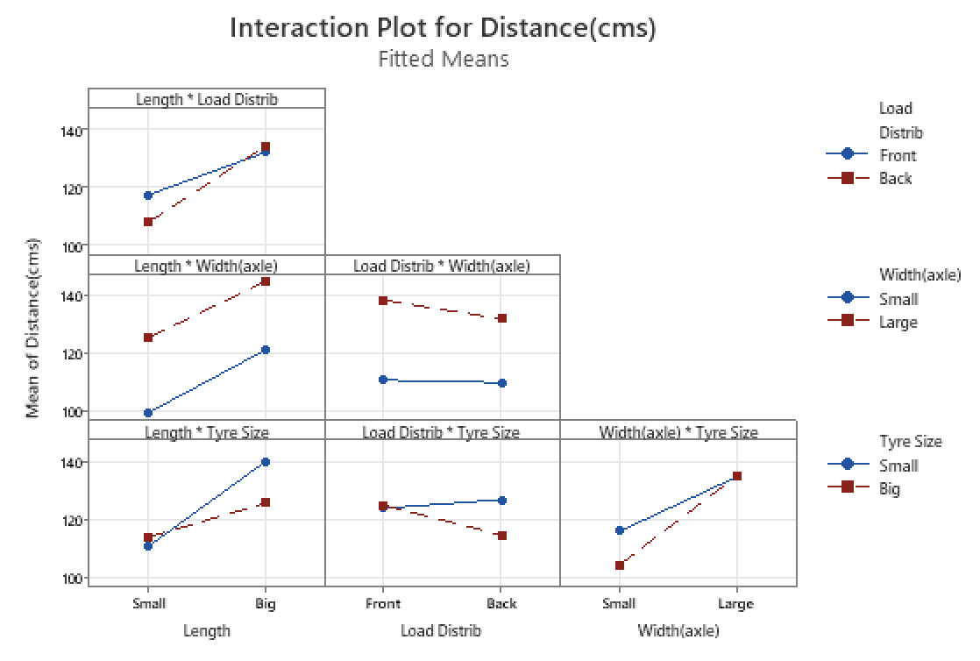
Length * Load Distribution: Interaction exists, but not very strong
Length * Width: Strong Interaction
Length * Tyre Size: Slight Interaction
Load Distribution * Width: Significant Interaction
Load Distribution * Tyre Size: Minor Interaction.
Width * Tyre Size: Small Interaction

Slide 12

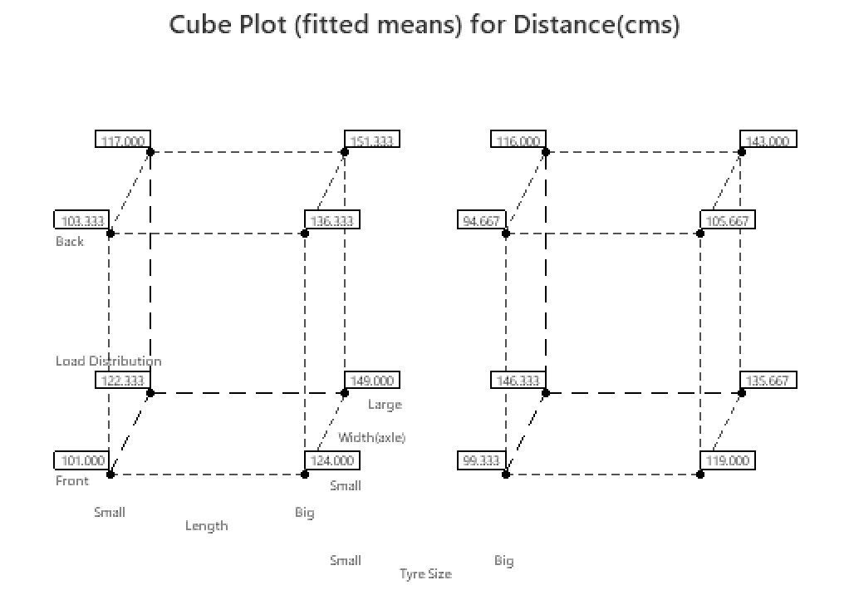
Big Length + Back Load + Large Width + Small Tyres = 151.33 cms
Big Length + Large Width -> Main effects
Small Tyres -> Regression & Interaction
Back Load -> Enhances performance

Slide 13

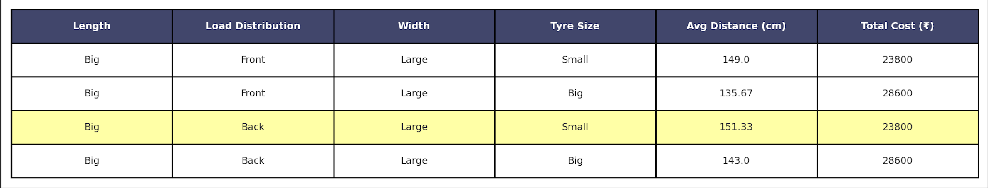

Slide 14

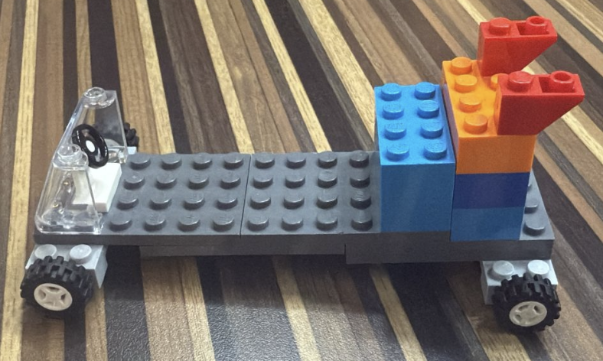
Length
Big
Load Distribution
Back
Width
Large
Tyre Size
Small
Distance
151.33 cms
Total Cost
$ 23800
151.33 cms23800

Slide 15


DOE is powerful. It helps not just individual effects, but how variables interact.
The importance of randomization and replication to eliminate bias and noise
Validate models using ANOVA, residual analysis & regression
Minitab and visualization tools make interpretation and decision-making easier
Notes:
Photo by Eric & Niklas on Unsplash

Slide 16


